Slide 1
INTRO TO HTML
MCNDHS
Ms. Eng

Slide 2
AIM: WHAT ARE SOME SEMANTIC HTML TAGS?
Do now:
Log into google classrooms wt2b2hd
Open up code pen please! codepen.io
**MAKE SURE YOU PLUG IN THE LAPTOPS** thank you!
Daily Grade:
On-time/attendance/not leaving the classroom: 25%
Cellphones: 25%
Notes:25%
Classwork/Homework: 25%

Slide 3

SEMANTIC HTML
semantic html is html that you use to alter text

Slide 4
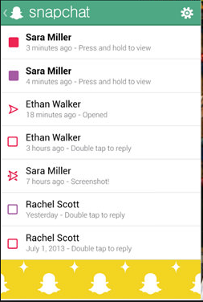
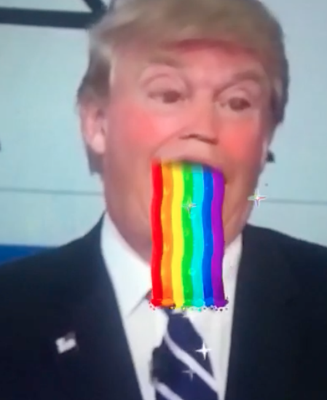
WHERE YOU SEE IT…

Slide 5
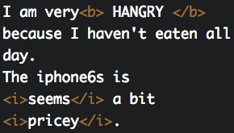

BOLD AND ITALIC
Bold: <b> </b>
Italic: <i> </i>

Slide 6




SUPERSCRIPT & SUBSCRIPT
Superscript: <sup></sup>
Subscript: <sub></sub>

Slide 7
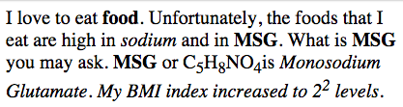
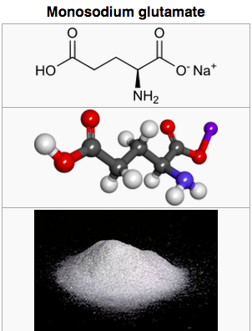
ACTIVITY
Question 2:
Recreate the following text:

